Slide 1
Maturity Model for Microsoft 365 Practitioners
Management of Content
June 2021
⭐Guest stars⭐ You!
Emily Mancini, Sympraxis Consulting | @eemancini Marc Anderson, Sympraxis Consulting | @sympmarc
Simon Doy, iThink 365 | @simondoy
Simon Hudson, Novia Consulting | @simonjhudson
Initiative started by Sadie Van Buren as SharePoint Maturity Model in 2010
Notes:
EMILY

Slide 2


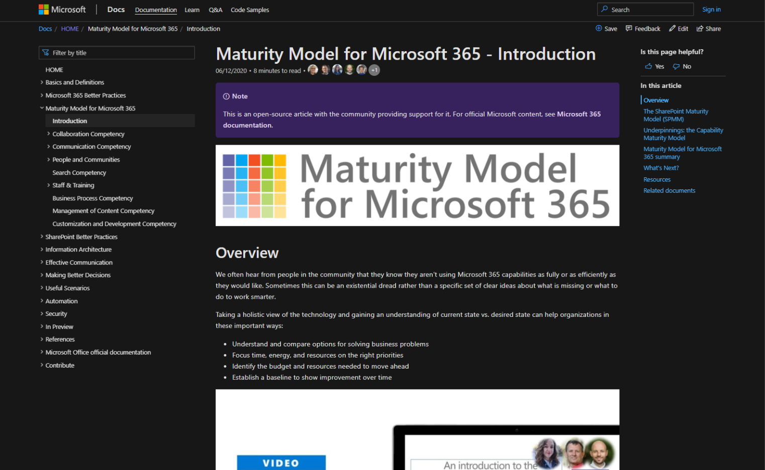
v
Agenda
Practitioner & Maturity Model overview
Artifacts and Updates
Purpose
How to get more involved
Shout-out & Picture Time (Together Mode!)
Discussion: Management of Content
Notes:
EMILY

Slide 3

The approach and articles on Microsoft Docs
https://aka.ms/m365-community-docs
Artefacts
Improve organization through use of technology
Benchmark company and department
Select appropriate approach
Develop an organizational business and technical roadmap based on:
What's possible
What's desired
Organization's culture and drivers
Lead and support strategic planning, with senior management
Align implementation needs and objectives
Discuss use of the platform with IT – not just technology
Socialization tool
PURPOSE
Published Competencies
Open Competencies
Supporting Articles
Business Process
In progress
Principles of…
Infrastructure
Collaboration
Search
Communication
Communication
To do
Management of Content
Security…
How to elevate…
People & Communities
Data & Analytics
Collaboration
Search
Communication
Staff & Training
People & Communities
Customization & Development
Staff & Training
Notes:
SIMON H

Slide 4
MM4M365 provides benchmarks to measure your organization
Maturity Level | Description | Keywords
Level 500 Optimizing | Deliberate and systematic process improvement/optimization Focus is on continually improving process performance Addressing statistical common causes of process variation and iterative process improvement | Optimal, systematic, statistical, improvement-focus, automated, assured, proactive
Level 400 Predictable | Actively managed in accordance with agreed processes and has tracked metrics Effective achievement can be evidenced across a range of operational conditions Process has been tested and refined Process users demonstrate competence | Productive, interactive, responsive, enhanced, effective, adaptable, quality
Level 300 Defined | Defined and standardized Signed off, managed process Limited validation of effectiveness, doesn’t include edge cases Process users demonstrate familiarity | Documented, policy-driven, planned, controlled, stable
Level 200 Managed | Key processes defined but not standardized, uniformly or strongly applied Some ability to demonstrate consistent outcomes Limited buy-in from staff and management Widespread inconsistency and resistance | Routine, legacy, fire-fighting, variable, personally managed
Level 100 Initial | Default, starting/exploratory state People driven processes, lacking documentation and discipline Many ways of doing the same thing (with variable results) Characterised by inefficient legacy approaches and pockets of unmanaged innovation | Ad hoc, reactive, uncontrolled, chaotic, unstable, not designed
Source: https://docs.microsoft.com/en-us/microsoft-365/community/microsoft365-maturity-model--intro
Notes:
SIMON H

Slide 5
Purpose
Discussion-based monthly meeting
Highlights of new assets
Understanding the competencies
Mapping technology to maturity levels and competencies
Running a workshop
Measuring maturity
Sharing anecdotes and success stories
Feedback on the maturity model
Safe space to hone your pitch, test your thoughts, or decide how to promote your use of the Maturity Model
OVERVIEW
Practitioners for
Maturity Model
for Microsoft 365
Get Involved
https://aka.ms/sharing-is-caring
Present case study (at MM4M365 Practitioners or other speaking opportunities)
Contribute on GitHub
Provide feedback, insights, tools, and artifacts
Socialize
content
Notes:
EMILY

Slide 6
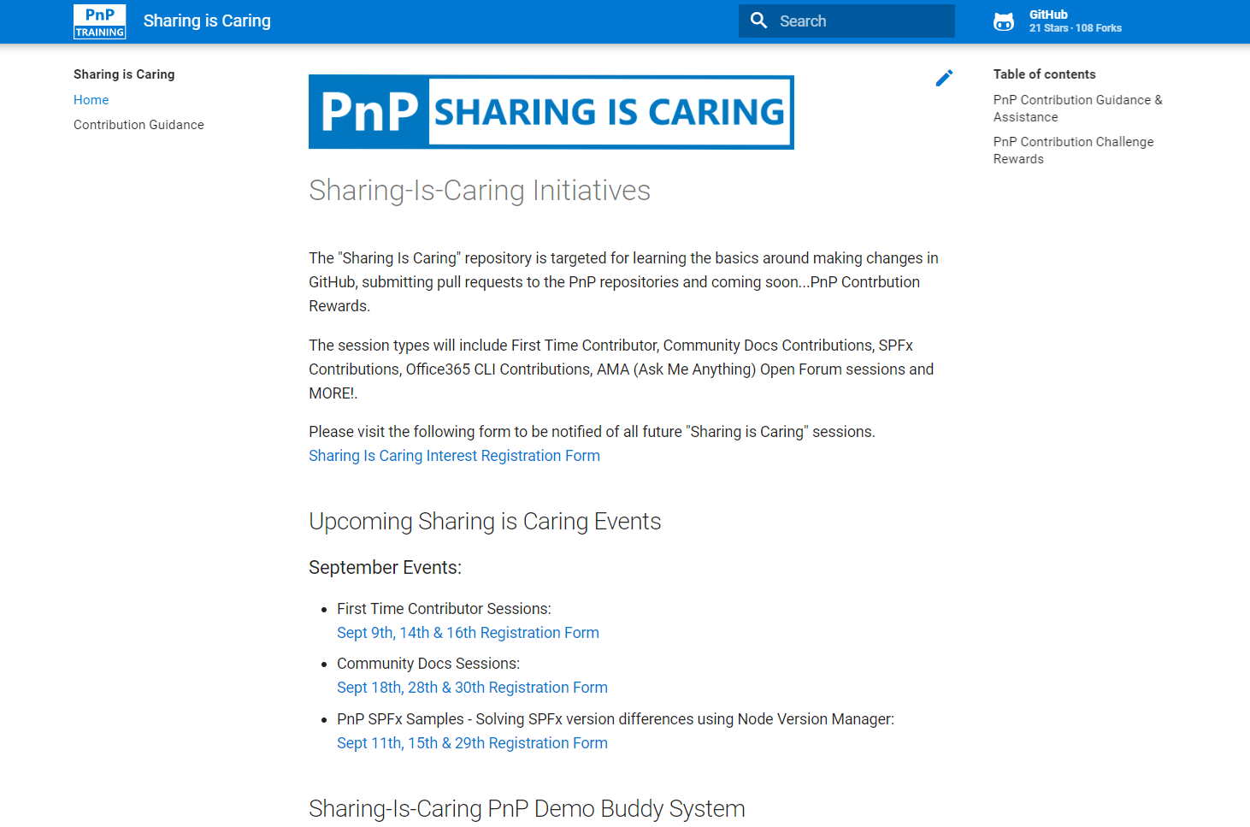

GUIDANCE
Get started on the open-source and community work?
Community Docs Sessions
Wednesday, June 23rd
First Time Contributor Sessions
Tuesday, June 29th
Thank you, May attendees
David Warner
Kathleen Boilek
Shilpa
Ariel Smith
Ralph Rivas
Theresa Lubelski
Susan McClements
Ron Jones
Alex Tabone
Simon Ågren
Nikki Chapple
Chris Revell
Andrew Burns
Patrick Tucker
Ross Allan
Henrik Yllemo
Julie Peck
Daniel
Shiva Bezwada
Melissa Declercq
Harold Wolfinger
Phil Broadbery
Nizar Grindi
Rocio Holub
Pete Simpkins
Kiran Bellala
Prabhjit Singh
Andy Boylan
Mike Duffy
Lance Yoder
Christine Green
Manjunath Puttaswamy
Tammie Brown
Daniel Westerdale
Michael Appinger
Next MM4M365 call
July 20th at 7:00am PST
Third Tuesday of every month
https://aka.ms/sharing-is-caring
Running a Maturity Model Workshop
https://aka.ms/sharing-is-caring
Notes:
EMILY

Slide 7
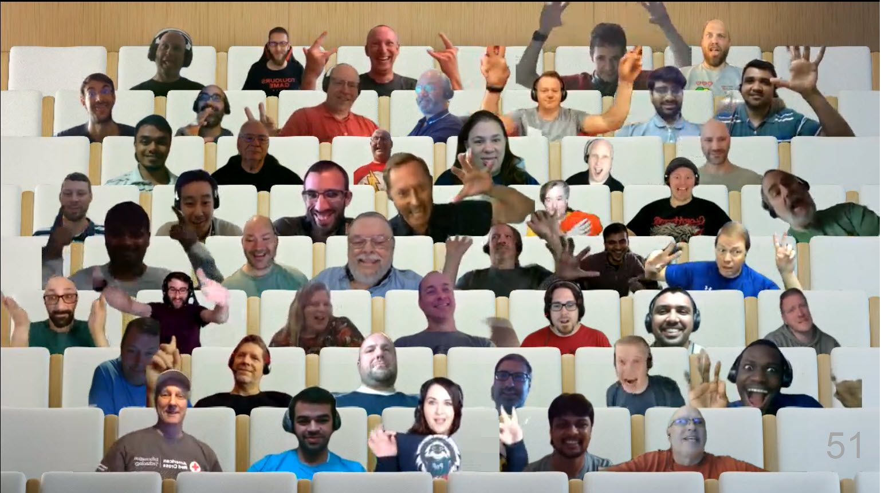

PnP Picture Time!
Video on and we’ll grab a Together Mode pic with everyone who wants to be seen to be here.
We are together in this as a community!
Notes:
EMILY

Slide 8

DISCUSSION
Management of Content
PROTOCOL
Visually emote and support Share reactions while others are speaking
Come off mute and share your thoughts
Share your camera (don’t be shy)
Raise your hand to say your piece (and put it down again!)
Notes:
SIMON D
Discuss the approach and how when first thinking about how to apply the maturity model it was all about the customisation and development competency. So when we are discussing the Power Platform we are think ingabout all the competencies and how they are applied from the maturity model.
Examples:
Communication – how do we inform people that the Power Platform is available? How we explain what the benefits and impact of the platform can be?
Staff and Training – how we we enable our teams to take advantage of the platform? What training is there, do we sign post to internal teams, external teams, on-line resources, do we buy courses via content providers such as linda.com or pluralsight or linked in learning....
Management of content – how do we manage the content related to the Power Platform the user guides / admin guides
People and Communities – we will talk about this more later but how do we enable people and communities around the Power Platform flourish and build a support network for the Power Platform citizen developers
Business Process -
Collaboration – How do we enable people to work together on these systems and describe what they want, what has been done etc.
Before we get into the discussion lets talk about what the Power Platform is.

Slide 9
DISCUSSION: What does Level 100 through 500 look like for Content Management? What is wrong? What have we missed? How else can we represent these concepts? Is this helpful?
Types of content
Documents
Web pages & News
Conversations
Items (e.g. snippets of information, FAQs, tasks, contacts, notifications, list items)
Email
Media
Common Microsoft 365 Toolsets
OneDrive
SharePoint
Teams
Data Loss Prevention
Azure
Azure Information Protection
Compliance Center
File services
Microsoft Lists
Email
Microsoft Word
OneNote
Stream
SharePoint Syntex
Power Automate
Project Cortex
Notes:
POLL: https://forms.office.com/r/DmUk6zw2NZ
Would you choose a particular part of the platform?
Source control?
Switch it on and let everyone go wild?

Slide 10
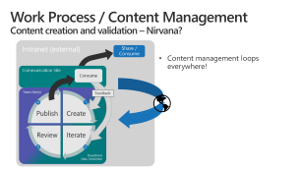
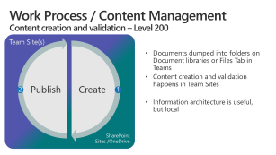
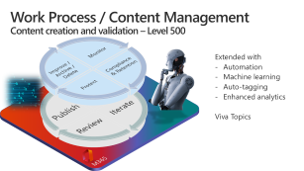
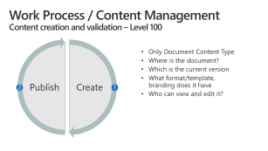
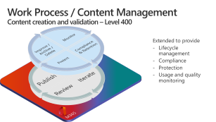
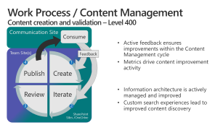
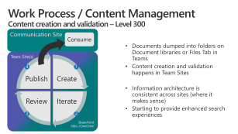
Overview

Slide 11
Work Process / Content Management Content creation and validation – Level 100
Create
Publish
Only Document Content Type
Where is the document?
Which is the current version
What format/template, branding does it have
Who can view and edit it?
2
1
Notes:
This content management cycle applies to almost anything we create, even in our personal lives. Consider working on a homework assignment in grade school. The same cycle holds.
Every Content Type has a different mix of these four activities and different levels of complexity driven by the business value or regulatory requirements for the content.

Slide 12
Work Process / Content Management Content creation and validation – Level 200
Team Site(s)
Create
Publish
Documents dumped into folders on Document libraries or Files Tab in Teams
Content creation and validation happens in Team Sites
Information architecture is useful, but local
2
1
SharePoint Sites /OneDrive
Notes:
This content management cycle applies to almost anything we create, even in our personal lives. Consider working on a homework assignment in grade school. The same cycle holds.
Every Content Type has a different mix of these four activities and different levels of complexity driven by the business value or regulatory requirements for the content.

Slide 13
Work Process / Content Management Content creation and validation – Level 300
Communication Site
Consume
Documents dumped into folders on Document libraries or Files Tab in Teams
Content creation and validation happens in Team Sites
Information architecture is consistent across sites (where it makes sense)
Starting to provide enhanced search experiences
Team Site(s)
Create
Iterate
Review
Publish
4
1
3
2
SharePoint Sites /OneDrive
Notes:
This content management cycle applies to almost anything we create, even in our personal lives. Consider working on a homework assignment in grade school. The same cycle holds.
Every Content Type has a different mix of these four activities and different levels of complexity driven by the business value or regulatory requirements for the content.

Slide 14
Work Process / Content Management Content creation and validation – Level 400
Communication Site
Consume
Active feedback ensures improvements within the Content Management cycle
Metrics drive content improvement activity
Information architecture is actively managed and improved
Custom search experiences lead to improved content discovery
Team Site(s)
Create
Iterate
Review
Publish
Feedback
4
1
3
2
SharePoint Sites /OneDrive
Notes:
This content management cycle applies to almost anything we create, even in our personal lives. Consider working on a homework assignment in grade school. The same cycle holds.
Every Content Type has a different mix of these four activities and different levels of complexity driven by the business value or regulatory requirements for the content.

Slide 15

Work Process / Content Management Content creation and validation – Level 400
Monitor
Compliance & Retention
Protect
Improve / Archive / Delete
M365
Create
Iterate
Review
Publish
Extended to provide
Lifecycle management
Compliance
Protection
Usage and quality monitoring
4
1
3
2
Notes:
This content management cycle applies to almost anything we create, even in our personal lives. Consider working on a homework assignment in grade school. The same cycle holds.
Every Content Type has a different mix of these four activities and different levels of complexity driven by the business value or regulatory requirements for the content.

Slide 16


Work Process / Content Management Content creation and validation – Level 500
Monitor
Compliance & Retention
Protect
Improve / Archive / Delete
M365
Create
Iterate
Review
Publish
Extended with
Automation
Machine learning
Auto-tagging
Enhanced analytics
Viva Topics
4
1
3
2
Notes:
This content management cycle applies to almost anything we create, even in our personal lives. Consider working on a homework assignment in grade school. The same cycle holds.
Every Content Type has a different mix of these four activities and different levels of complexity driven by the business value or regulatory requirements for the content.

Slide 17

Work Process / Content Management Content creation and validation – Nirvana?
Intranet (external)
Share / Consume
Content management loops everywhere!
Communication Site
Consume
Team Site(s)
Create
Iterate
Review
Publish
Feedback
4
1
3
2
SharePoint Sites /OneDrive

Slide 18
Future topic ideas
Running a Maturity Model workshop
Retention
Compliance
Search
Business process
Advanced content management
Communication
Collaboration
July 20, 2021

Slide 19
Thank you
Follow us on Twitter
@M365Maturity | @M365CommDocs
Take the Maturity Model Self-Assessment
https://symp.info/MM4M365-SelfAssessment
Fill out the Maturity Model Survey
https://symp.info/MM4M365Survey
Discussions in Github
https://symp.info/MM4M365Discussion
Next MM4M365 monthly call: July 20th at 7:00am PST
Third Tuesday of every month
https://aka.ms/sharing-is-caring

Slide 20


aka.ms/m365pnp

